Slide 1
SWIGGY
ANALYSIS
By Mohamed Askaf

Slide 2
Introduction
Swiggy is India’s largest online food item ordering & delivery chain, It’s a Bangalore-based startup started in 2014, and as of now, it’s expanded to more than 100 Indian cities. Swiggy propelled quick pick-and-drop food delivery applications to make the life of people simpler.
Founders
Sriharsha Majety, Nandan Reddy, and Rahul Jaimini

Slide 3
Swiggy Business Model
Delivery Charges: The main sort of income stream Swiggy acquired is from its customers. The company collects delivery charges from customers on the order that costs less than their minimum order of Rs. 250. A charge of 20 to 40 rupees is charged on per order.
1
Commissions: Swiggy acquires another major part of the revenue stream from commissions. It collects commissions from restaurants to generate sales leads and to deliver their food items through Swiggy’s application. Restaurants have to pay 15% to 25% on every order placed from Swiggy’s site.
2

Slide 4
Advertisement: Swiggy also procures advertising income in different ways. It shows advertisements of different restaurants on its app and charges address cost to get them promoted in various regions. Also, some restaurants and cafes pay premium rates to Swiggy to get prioritised on the app from the list of accessible eateries.
3
Swiggy Access: The start-up has come up with the most innovative idea i.e. cloud kitchen idea. It gives its restaurant partners a ready-to-use kitchen area in those zones where they don’t work. It brings food closer to its customers and empowers restaurants to set up their kitchen in new areas. Swiggy expects to get 25% of income from Swiggy access facility and incorporated 30 partners with 36 kitchens.
4

Slide 5
7865
9
832
Restaurants
City
Area

Slide 6
Methodology for Swiggy Data Analysis Project
Data Collection:
Identify and access data sources (Swiggy API, web scraping, available datasets).
Gather data on cuisine types, locations, order volumes, customer ratings, delivery times, and pricing.
1
Data Preparation:
Clean the data to handle missing values and outliers.
Normalize data for consistency (e.g., standardize location names, convert time formats).
Transform data to create relevant features (e.g., average delivery time, cuisine popularity index).
2
Exploratory Data Analysis (EDA):
Analyze the distribution of cuisines across different cities.
Identify trends in cuisine popularity over time.
Examine correlations between variables like pricing, delivery time, and customer satisfaction.
3

Slide 7
Insights Generation:
Determine the most popular cuisines in each city.
Analyze delivery performance and its impact on customer ratings.
Compare pricing strategies across cities and assess their effectiveness.
4
Power BI Dashboard Development:
Import the cleaned and processed data into Power BI.
Model the data to establish relationships between tables.
Create visualizations:
Map visualizations to show cuisine distribution geographically.
Bar/column charts for cuisine popularity and order volumes.
Trend lines to visualize time-based data.
Pie/donut charts to represent cuisine proportions.
Filters and slicers for interactive data exploration.
Implement drill-downs and tooltips for detailed insights.
5

Slide 8
Interpreting Results:
Provide strategic recommendations based on data insights.
Tailor strategies for each city considering local trends and preferences.
6
Continuous Monitoring and Improvement:
Set up automated data refreshes in Power BI for real-time updates.
Regularly iterate on the dashboard based on feedback and new data trends.
7

Slide 9
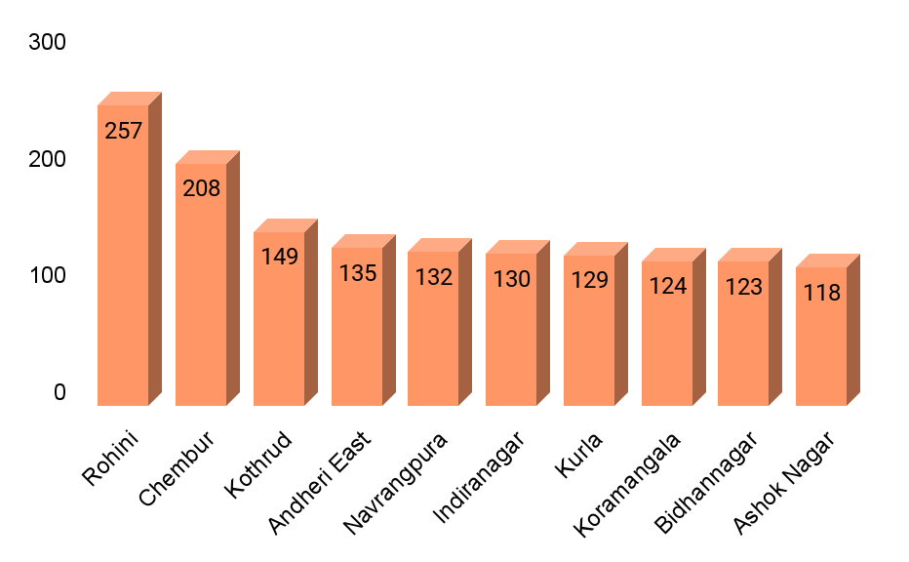
Top 10 Areas with Most Restaurants
Swiggy services a total of 7,865 restaurants, with 1,505 (approximately 20%) located in the top 10 areas. The majority of these 1,505 restaurants are in Mumbai and Bangalore, each with three areas in the top 10. Mumbai, which has 472 restaurants, includes the areas of Chembur, Andheri East, and Kurla. Bangalore, which has 367 restaurants, includes the areas of Indiranagar, Koramangala, and Ashok Nagar.

Slide 10
Most Popular Food Types Served by Swiggy Restaurants in Each City
Hyderabad has the most South Indian cuisine, showing it’s very popular there. Chennai and Bangalore also have a good number of South Indian dishes. Mumbai leads in Chinese cuisine, suggesting a strong preference for it. Kolkata and Delhi have a lot of Indian and North Indian cuisine. Pune and Surat offer more Chinese and fast food options.

Slide 11
Top Rated Swiggy Restaurants
4%
Only 4% of restaurants have a top rating between 4.6 and 5.0. There are 295 of these top-rated restaurants, mostly found in Chennai, Kolkata, Mumbai, Pune, and Bangalore.

Slide 12
Correlation of Factors Affecting Average Rating
The correlation between average rating and delivery time is negative, indicating that faster delivery leads to higher ratings. Higher average ratings are also associated with better value for money, suggesting that customers are satisfied with the quality of food. Additionally, higher average ratings correspond to higher total ratings, meaning more customers prefer high-rated restaurants.

Slide 13
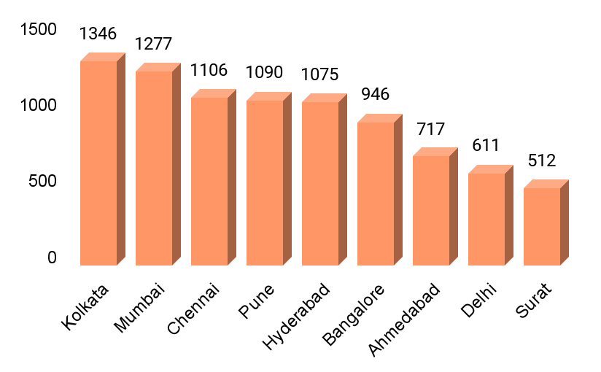
City-wise Restaurant Count
Kolkata has 17.11% of the restaurants, Mumbai has 16.24%, and Chennai has 14.06%. Pune has 13.86%, Hyderabad has 13.67%, and other cities make up the remaining 35.43%. This distribution shows that a significant portion of restaurants are concentrated in these key cities, with Kolkata having the largest number of restaurants.

Slide 14
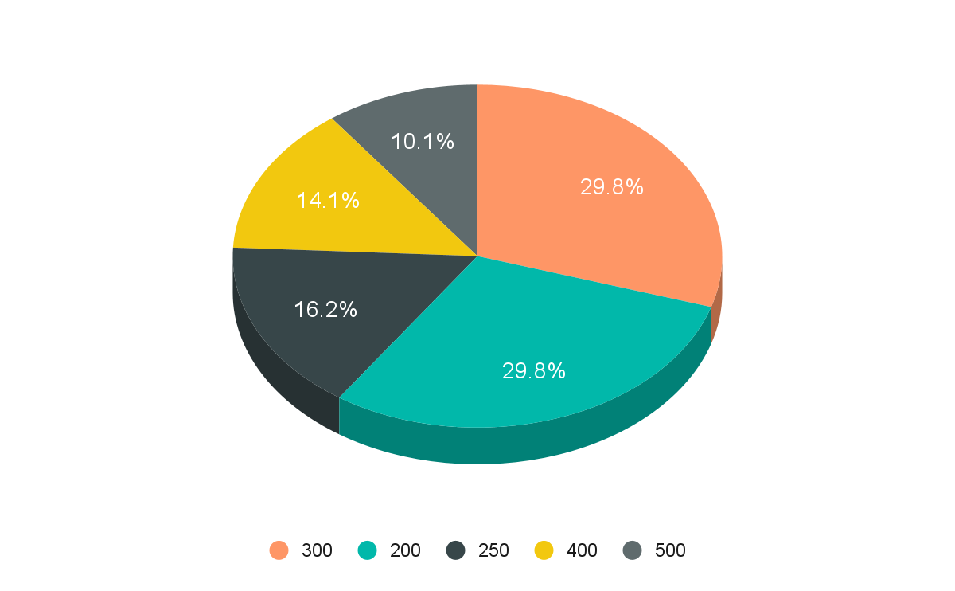
Price Analysis
Prices range from 1 to 2,500, with most falling between 200 and 300. The next most common range is 400 to 500. On average, restaurant prices are 348.

Slide 15
Delivery Time Analysis
50
Heavens Kitchen takes 109 minutes of average time for food delivery, which is the highest number of all restaurants.There are approximately 2683 restaurants, and the average delivery time is more than 60 minutes. Within 60 minutes, 2172 restaurants are there. Within 30 to 50 minutes, 3824 restaurants are there. Scoops: one-only restaurants take 20 minutes for delivery of food, and this is the least or fastest time.
Average Delivery Time of all Restaurants

Slide 16
Cuisine Analysis
There are a variety of cuisines offered by different restaurants. North Indian, South Indian, Chinese, Continental, Oriental, American, and Mughlai cuisines are available.

Slide 17
Area-wise Restaurant Analysis
Ahmedabad, with 81 areas, has 709 restaurants, while Bangalore has slightly fewer areas (77) but more restaurants (938). Chennai, with 79 areas, has 1,096 restaurants, showing a higher concentration of dining options. Delhi also has 81 areas but only 611 restaurants, making it less restaurant-dense. Hyderabad, which has the most areas (150), features 1,030 restaurants. Kolkata has 136 areas and the highest number of restaurants at 1,325, which accounts for approximately 10.5% of the total restaurants mentioned. Mumbai, despite having just 68 areas, hosts 1,253 restaurants, representing about 10% of the total, indicating a high density of restaurants per area. Pune has 91 areas and 1,080 restaurants, making up roughly 8.5% of the total. Surat, with 79 areas and 505 restaurants, has the fewest restaurants, comprising only about 4% of the total.

Slide 18
Customer Feedback Analysis
Approximately 40.1% of restaurants are rated as "excellent" by customers, meaning they have a rating close to 5.0. About 38.46% are rated as "average" (around 3.0), 21.43% are rated as "good" (around 4.0), and a very small portion, just 0.01%, are rated as "fair" (around 2.0).
In Kolkata and Chennai, most restaurants are rated as "excellent" by customers, with ratings close to 5.0. In Hyderabad, most restaurants fall under the "good" category, with ratings around 4.0. Meanwhile, in Mumbai and Pune, the majority of restaurants are rated as "average," with ratings around 3.0.

Slide 19
Geographical Mapping
9
9 major cities have been serviced by Swiggy; those are all Chennai, Bangalore, Hyderabad, Mumbai, Kolkata, Pune, Surat, Ahmedabad, and Delhi.

Slide 20
Recommendation
28% of restaurants are considered low performers, meaning they attract fewer customers. factor is their lack of recognition. To address this, Swiggy identifies and promotes lesser-known restaurants through targeted advertising, aiming to improve their visibility and attract more customers.
Swiggy should focus on reducing delivery times to under 60 minutes by optimizing delivery routes, increasing delivery personnel during peak hours, and collaborating with restaurants for faster order preparation. Additionally, ensuring high-quality, standardized packaging that maintains food integrity during transit is essential. By addressing these areas, Swiggy can enhance customer satisfaction and boost overall ratings.
Identify good restaurants and contact their owners to list their food on Swiggy. This is important because some cities have fewer restaurant options.

Slide 21
THANK YOU

